Slide 1
THE INSTITUTE OF CHARTERED ACCOUNTANTS OF INDIA
(Set up by an Act of Parliament)
Presentation on ICAI @75
by
CA. Ranjeet Kumar Agarwal,
Vice-President, ICAI

Slide 2
History of ICAI
1948
Cabinet approved the establishment of an autonomous body ICAI designation, “Chartered Accountant” for all Registered Accountants.
1949
Bill Passed Dominion Legislature which came into force on 1st July, 1949
5th & 6th May,1948- Expert Committee Meeting headed by Mr. C.C. Desai, then Secretary of Commerce recommended formation of an Autonomous body of Accountants “The Institute of Chartered Accountants of India”.
THE INSTITUTE OF CHARTERED ACCOUNTANTS OF INDIA
(Set up by an Act of Parliament)

Slide 3
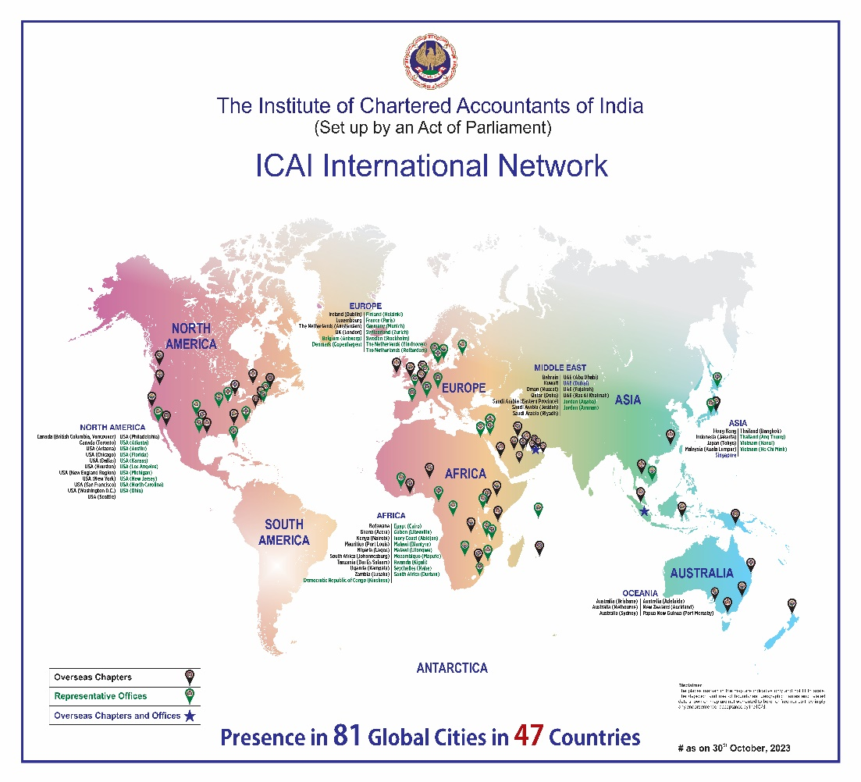
ICAI at a glance
5 Regional Councils
171 Branches
48 Overseas Chapters
33 Rep Offices
12.5 Lac Members & Students
THE INSTITUTE OF CHARTERED ACCOUNTANTS OF INDIA
(Set up by an Act of Parliament)

Slide 4
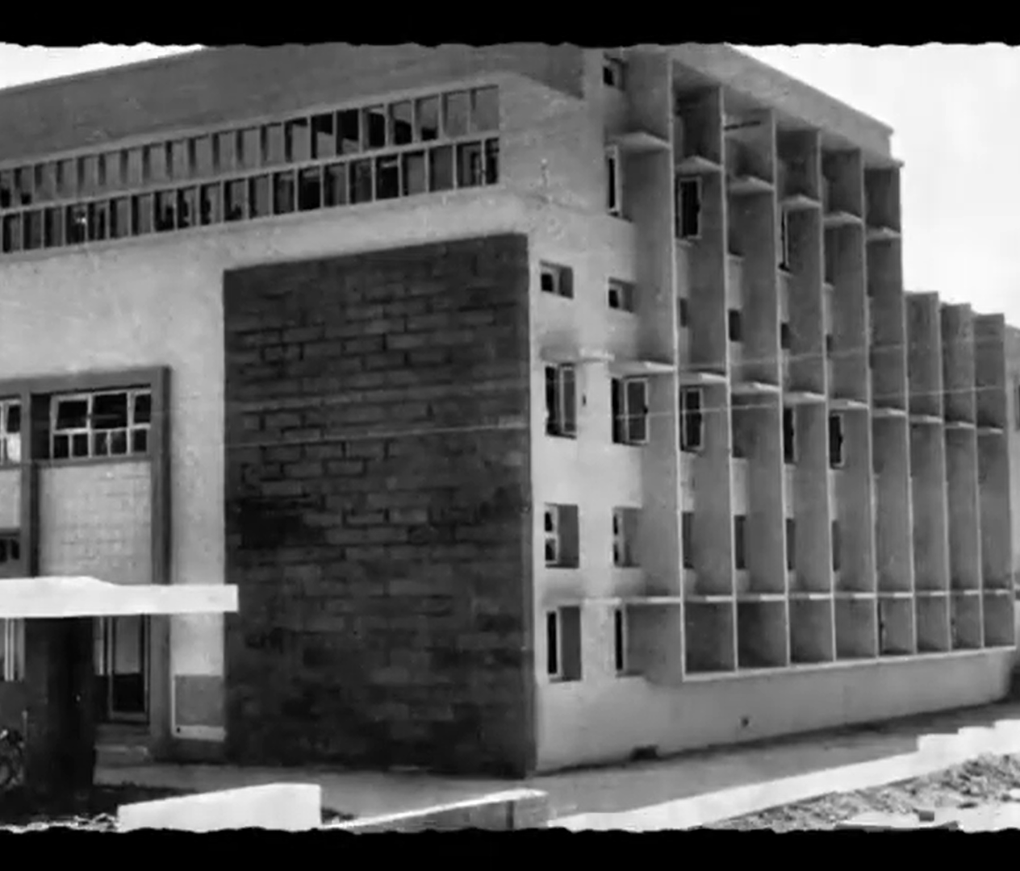
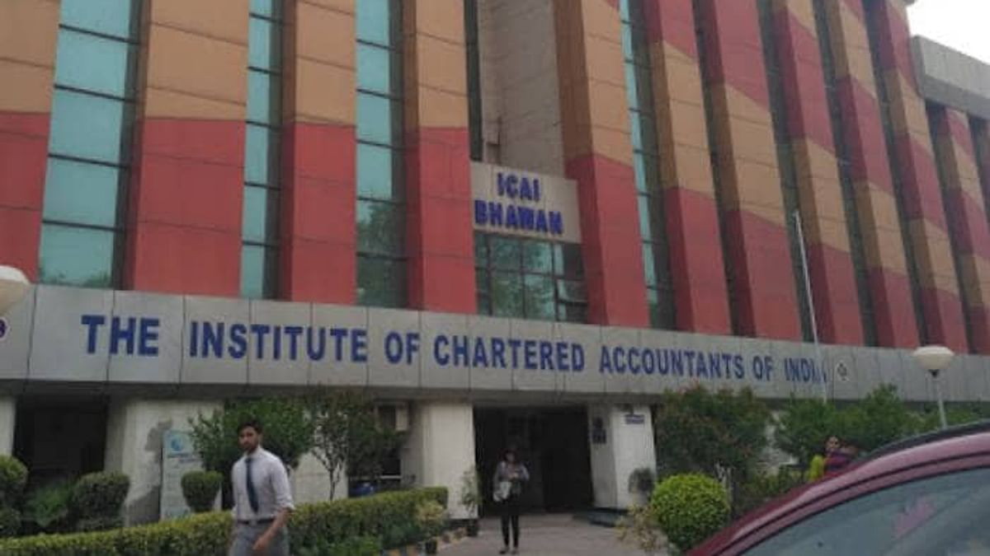
ICAI : Now & Then
1685
3,84,194
THE INSTITUTE OF CHARTERED ACCOUNTANTS OF INDIA
(Set up by an Act of Parliament)

Slide 5
Students at a glance
The Hon’ble Supreme Court Justices Sanjay Kishan Kaul and MM Sundresh ) in its recent order in January, 2022 ICAI Examination system:
Look at how ICAI does it for Chartered Accountants. They control intake and also the quality…..”
8,47,689
Affordability
Empowerment
Intrinsic Value Connect
25,000 Members p.a.
THE INSTITUTE OF CHARTERED ACCOUNTANTS OF INDIA
(Set up by an Act of Parliament)

Slide 6
1978 1988 1998 2008 2017 2023
New Scheme of Education and Training of ICAI
New Scheme of Education and Training of ICAI-Redefined Contemporary Curriculum
Multi-disciplinary Subjects Specialisation
Ethics & Technology all Core Subjects at Final Level
2 Years Uninterrupted Practical Training
Experiential Learning Self-paced Online Modules
Emphasis on Emerging Technologies Training
Recognition as Business Accounting Associate (BAA) – An Exit Route
Country Specific International Curriculum & Training
30% Case Scenario based MCQs -Inter and Final Level
Focus on Strategic Decision Making
THE INSTITUTE OF CHARTERED ACCOUNTANTS OF INDIA
(Set up by an Act of Parliament)

Slide 7
NACAS (2001-Sec 210A of CA 1956)/ NFRA (Sec 132 of CA 2013- 2019)
Standard Setting by ICAI
~Accounting Standards (28) ~IND-AS (41) ~AASB (46)
EE ~Ethical Standards ~ Valuation Standards (10)
~Social Audit Standards (16). ~Internal Auditing Standards (22)
Forensic Accounting & Investigating Standards (23)
THE INSTITUTE OF CHARTERED ACCOUNTANTS OF INDIA
(Set up by an Act of Parliament)
Notes:
a core research body to promote research in the areas of accounting, auditing, capital markets, fiscal policies, monetary policies and other related disciplines.
XBRL India
The objective is to o enroll and regulate registered valuers as its members in accordance with the Companies (Registered Valuers and Valuation) Rules, 2017.
to enrol and regulate insolvency professionals as its members in accordance with the Insolvency and Bankruptcy code 2016 and read with regulations.
to enrol, regulate and develop the Social Auditors in an independent and transparent manner. ISAI will also work on capacity building of the social auditors through continuous professional education and training.

Slide 8
Regulatory Role of ICAI
Professional Ethics & Code of Conduct-1963
Financial Reporting Review
Board (FRRB)- 2002
Peer Review
Board (PRB)- 2002
Quality Review
Board (QRB)- 2007
Sec 28A in CA Amendments in 2006
Taxation Audit
Quality Review
Board (TAQRB)- 2018
Strengthened
Disciplinary
Regime- 2019
Unique
Documentations
Identification
Number (UDIN)- 2019
Centre for Audit
Quality
2020
THE INSTITUTE OF CHARTERED ACCOUNTANTS OF INDIA
(Set up by an Act of Parliament)

Slide 9
Board of Discipline
THE INSTITUTE OF CHARTERED ACCOUNTANTS OF INDIA
(Set up by an Act of Parliament)

Slide 10
Disciplinary Committees
2
THE INSTITUTE OF CHARTERED ACCOUNTANTS OF INDIA
(Set up by an Act of Parliament)

Slide 11
Total Districts in India : 763+ Total Pin Codes in India : 19100 +
Udin Directorate
Increased significance among Government Departments and stakeholders
Mandated by Various State Governments In their tender Forms for judging financial capability
Validation of the UDINs on real time basis by CBDT
Consideration as a seal of Authentication
THE INSTITUTE OF CHARTERED ACCOUNTANTS OF INDIA
(Set up by an Act of Parliament)

Slide 12
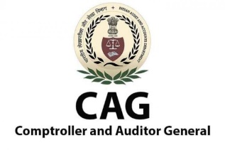
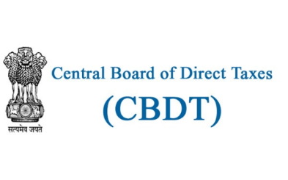
National Recognition of UDIN
International acknowledgement of UDIN
2
4
THE INSTITUTE OF CHARTERED ACCOUNTANTS OF INDIA
(Set up by an Act of Parliament)
Notes:
National Recognition of UDIN
Hon'ble Comptroller and Auditor General of India Sh. Rajiv Mehrishi on UDIN at 69th Platinum Jubilee Annual Function of ICAI on 4th February 2019 - I was very impressed when I learned about the Unique Document Identification Number (UDIN) because that really protects every member of profession from being defrauded by means of copying of their signatures or seal. All in all, I would not like to repeat all the activities and outcomes that the ICAI has been achieving over the last few decades under the very able and guiding leadership but I must say that without doubt it has now outshone its mother Institute, the Institute of Chartered Accountants of England and Wales.
Ministry of Corporate Affairs had appreciated the initiative of ICAI for bringing this concept of UDIN which will eradicate the practice of bogus certificates and save various regulators, banks etc. from being misled.
Central Board of Direct Taxes (CBDT) has highly appreciated the concept of UDIN which will enable the regulators to easily verify the authenticity of the documents certified by CAs and have mandated the validation of the UDINs in all the IT forms and Tax Audit Reports filed by CAs at the e-filing portal.
The Central Bureau of Communication (CBC), Government of India approached the UDIN Directorate, for placing systematic reliance on UDIN to assess the veracity of the information certified by Chartered Accountants in the prescribed format for the empanelment of the news agencies based on circulation and rates. The certified information by a Chartered Accountant becomes a basis for empanelment of the news agencies.
RERA authorities of many states have already included a column for mentioning UDIN in the certificates/forms issued by CAs.
SEBI has included column for mentioning UDIN in their forms issued by CAs.
Indian Banks' Association has communicated to all the Banks to Impress for UDIN in all certificates certified by CAs submitted to them.
International Acknowledgement of UDIN
3rd meeting of the Task Force to implement UDIN in SAFA Member Bodies was held on 22nd June 2021.
Presentation of UDIN to IFAC Council during International Networking Meet organized by British Columbia, Vancouver, Chapter of ICAI in November, 2019.
Presentation of UDIN at 11th Annual General Meeting of Asian Oceanic Standards Setters Group (AOSSG) in November 2019 at Goa.
ICAI heads the SAFA Task Force to implement the UDIN in SAFA Member Bodies and had 1st Meeting on 29th July, 2019 in Colombo, Sri Lanka.
The 21st World Congress Of Accountants (WCOA) held in Mumbai during 18-21 November, 2022, exclusively discussed the significance, impact and consequences of the UDIN for safeguarding the interest of the profession among others under the theme namely. Robust Regulatory Framework The panelists impressed upon the uniqueness of the UDIN as also it's being one of the pivotal instruments of institutional governance.

Slide 13
Financial Reporting Review Board
SELECTION OF ENTERPRISES FOR REVIEW
SEGREGATION OF REVIEWS CONDUCTED BY THE BOARD
Suo-Motto Cases 857
Special Cases 253
Total Cases 1110
SUO-MOTTO
79%
SPECIAL CASES
21%
Advisory Issued (LOA)
64%
Referred to Director Discipline
16%
Referred by another regulator: MCA, SEBI, C&AG, ECI
Accounting irregularity highlighted in media reports
No material non-compliance observed
17%
Reports sent to ECI
3%
THE INSTITUTE OF CHARTERED ACCOUNTANTS OF INDIA
(Set up by an Act of Parliament)

Slide 14
Under the Supervision/Guidance of Respective Ministry /Regulators (IBBI/MCA/SEBI/RBI)
Extended organs of ICAI (Sec. 8 Companies)
ICAI Accounting Research Foundation (India Railways)
XBRL India
ICAI Registered Valuers Organisation
Indian Institute of Insolvency Professionals of ICAI
Institute of Social Auditors of India
THE INSTITUTE OF CHARTERED ACCOUNTANTS OF INDIA
(Set up by an Act of Parliament)
Notes:
a core research body to promote research in the areas of accounting, auditing, capital markets, fiscal policies, monetary policies and other related disciplines.
XBRL India
The objective is to o enroll and regulate registered valuers as its members in accordance with the Companies (Registered Valuers and Valuation) Rules, 2017.
to enrol and regulate insolvency professionals as its members in accordance with the Insolvency and Bankruptcy code 2016 and read with regulations.
to enrol, regulate and develop the Social Auditors in an independent and transparent manner. ISAI will also work on capacity building of the social auditors through continuous professional education and training.

Slide 15
Some Major Initiatives
CAG- Urban Local Bodies
Tax Clinics
MSME
TITLE
11 CoEs
MOUs with Various State Govt.
Financial/ Tax Literacy
BAA (Business Accounting Associate)
MOUs with NITI Aayog
GST Training to Govt. Officials
THE INSTITUTE OF CHARTERED ACCOUNTANTS OF INDIA
(Set up by an Act of Parliament)

Slide 16
Some Major Initiatives
Digital Competency Maturity Model(DCMM)
Audit Quality Maturity Model(AQMM)
Digital Learning Hub(DLH)
Format for presenting the financial statements of non-corporate entities (NCEs)- The Accounting Standards Board of ICAI has issued a Guidance Note prescribing the format for the same. The same shall be applicable from April1, 2024. It aims to ensure consistent and effective application of the accounting standards for strengthening and standardising the financial reporting system of these entities.
Centre for Audit Quality(CAQ) has issued various Utilities for improving Audit Quality such as Excel Utility for Brank Branch Audit and for Determining Materiality.
AASB of ICAI constituted Expert Panels for addressing related Queries and brought out various publications of importance.
TITLE
THE INSTITUTE OF CHARTERED ACCOUNTANTS OF INDIA
(Set up by an Act of Parliament)

Slide 17
"Global Presence”
Member of 13 International Accountancy Forum
International Standards in Accounting, Auditing & Code of Ethics
Significant Technical Contribution in Standard Setting Process
8 MRA &
16 MOUs
48 Chapters
33 Rep Offices
Reciprocity u/s 29 of CA Act
Canada/UK
International Curriculum
Foreign Language Course (4+2)
Approx 40,000 CAs working outside India
Associate Membership of Singapore
Proud Host of WCOA
GloPAC
THE INSTITUTE OF CHARTERED ACCOUNTANTS OF INDIA
(Set up by an Act of Parliament)

Slide 18
Request for Views
Profession@100
Vision of the next 25th years
75th Year of Foundation
THE INSTITUTE OF CHARTERED ACCOUNTANTS OF INDIA
(Set up by an Act of Parliament)

Slide 19
Vision 2049
Particulars | 1949 | 1974 | 1999 | 2023 | 2049
India's GDP | $30.60 Bn | $99.53 Bn | $458.82 Bn | $3.5 Tn | $30 Tn (Apprx)
Population | 0.36 Bn | 0.61 Bn | 1.04 Bn | 1.42 Bn | 1.63 Bn
India's Economy Ranking | 142nd |  | 13th | 5th | 3rd
COP Holders Non- COP Holders Total | 1,147 542 1,689 | 3,066 952 4,018 | 53,829 36,537 90,366 | 1,56,074 2,28,120 3,84,194 | -
No. of Students |  | 12,270 | 5,48,224 | 8.47,689(Active) 2,106,992(Inactive) | -
No. of Accounting Bodies | 40 | 87 | 153 | 186 | -
Countries with Accountancy Bodies | 32 | 71 | 122 | 141 | -
No. of Countries | 102 | 191 | 197 | 195 | -
THE INSTITUTE OF CHARTERED ACCOUNTANTS OF INDIA
(Set up by an Act of Parliament)

Slide 20
Vision for next 25 Years
Global Leader in Accounting
Profession
100% Financial & Tax
Literacy to Citizen
Legislative Support to the
Parliament
100% Paperless ICAI
(SSP/E-Office)
Legal Protection to
CAs
Dr Kislay Pandey,Lawyer of Supreme Court
Robust Financial Reporting
In Country
India can be Accountants
Of the World
Partner in National
Building
THE INSTITUTE OF CHARTERED ACCOUNTANTS OF INDIA
(Set up by an Act of Parliament)

Slide 21
ICAI horizons are Inter-Generational.We value Longer Term Learning,Research & Social Benefit attached.
THE INSTITUTE OF CHARTERED ACCOUNTANTS OF INDIA
(Set up by an Act of Parliament)

Slide 22
“Glorious Past”
“Inspiring Future”
THE INSTITUTE OF CHARTERED ACCOUNTANTS OF INDIA
(Set up by an Act of Parliament)

Slide 23
THANK YOU…
THE INSTITUTE OF CHARTERED ACCOUNTANTS OF INDIA
(Set up by an Act of Parliament)

